Slide 1

VERQUVO® 2023 Marketing Budget Optimization
Impact Assessment & Investment Optimization
HH Digital, Data and Analytics (HHDDA)
Aug 17th, 2023

Slide 2
Custom Vendor-Level Constraints
Maximum vendor-level constraints are less than estimated in-scope¹ budget of $14M for 2024. As a result, scenarios on next slide will reflect this (i.e., total budget must be between min/max constraints). In each scenario, please note that almost all channels tend to reach (or nearly reach) max constraints. Those channels are highlighted here.
If the $14M in-scope¹ budget is preferred for 2024 scenarios, these constraints must be adjusted.
Dropping TrendMd/DGC/Dox=-$242K spend Adding Numedis/ReachMD =~ +$550K spend NET =~+$308K
¹In-Scope channels : HCP MCM, HCP MMF, HCC InOffice, HCC Social, HCC Display, HCC Paid Search, Samples and Vouchers

Slide 3
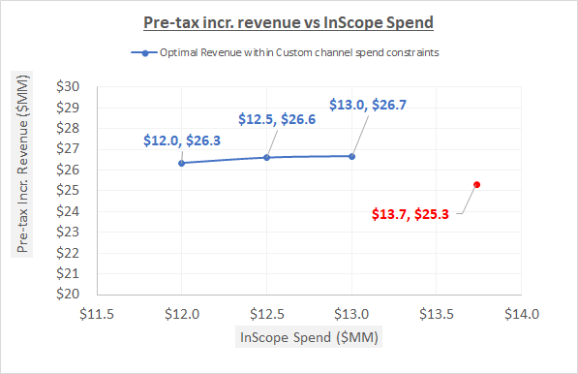
Optimal Scenarios with Custom Constraints
A reduction in the current in-scope¹ budget yields a small gain in revenue simply by optimizing within vendor/channel constraints.
By optimizing a slightly reduced in-scope¹ budget ($12M-$13M), a $1M-$1.3M gain in Revenue is estimated.
Please note: the $13.7M excludes the 3 HCP vendors that out of consideration for 2024.
These calculations assume that the non-analyzable budget can decrease proportionately to the in-scope budget
¹In-Scope channels : HCP MCM, HCP MMF, HCC InOffice, HCC Social, HCC Display, HCC Paid Search, Samples and Vouchers

Slide 4
Optimal Scenario deep dive (custom constraints)
A reduction in the current in-scope¹ budget yields a small gain in revenue simply by optimizing within vendor/channel constraints.
Please note: the $13.7M excludes the 3 HCP vendors that out of consideration for 2024.
*Samples are requested and received by prescribers for use by and benefit of patients. Samples provide the opportunity to gain experience with a product. The sample-related values shown here reflect the association between samples and new patient starts rescaled into TRx terms for comparability to other investment types; this applies to vouchers as well, which are treated as an alternative mechanism to provide samples to patients. (vs. samples left by Field personnel).

Slide 5
APPENDIX
(previously shared slides are on the following pages – these included channels that are not in scope for 2024 and did not include any custom constraints)

Slide 6
Objective and Executive summary
Objective: Suggest optimal investment across In-scope HCC & HCP channels for a given budget to maximize the overall impactable revenue in 2024.
2023 In-scope¹ estimated budget contribution: The In-Scope¹ investment of $14M (total budget $32M) is estimated to generate ~$25.4M in 3-yr pre-tax incremental revenue (ROI excl. samples/vouchers=1.1:1).
2023 Optimal Spend and allocation: The In-Scope¹ investment of $14M is estimated to generate ~$28.8M in 3-yr pre-tax incremental revenue (ROI excl. samples/vouchers=1.3:1).
¹In-Scope channels : HCP MCM, HCP MF, HCC InOffice, HCC Social, HCC Display, HCC Paid Search, Samples and Vouchers

Slide 7
Agenda
Understanding analyzable budget
Budget scenarios and impact on incremental revenue
Channel promotion efficiency and responsiveness
Deep-dive budget scenarios

Slide 8
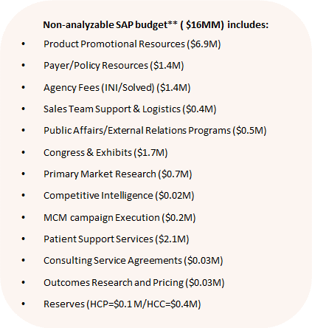
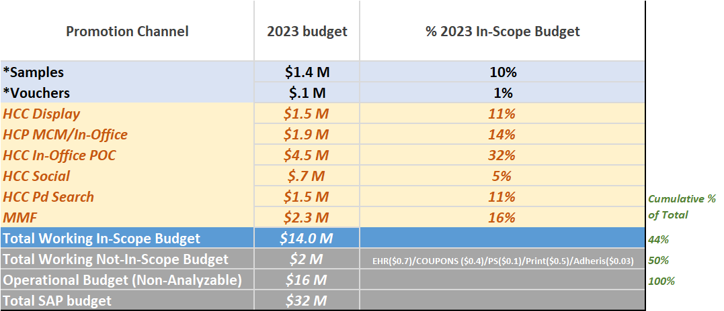
In-Scope Promotion Budget for Analysis
~44% ($14M) of the total 2023 VERQUVO® promotion budget was analyzed
The combined working budget represents 50% of the total budget
* Includes only Cost of Goods (COG) for Samples and reimbursement cost for Vouchers
**Source: Media Plans dated July’23, SAP Report dated June’23

Slide 9
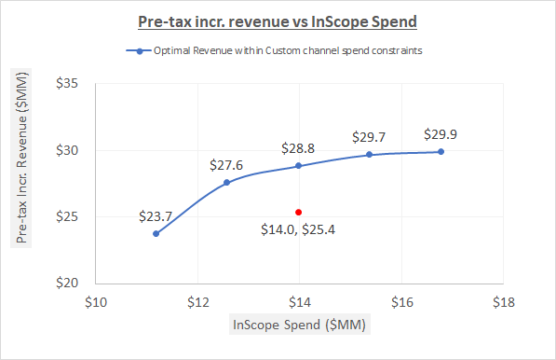
Optimal Scenarios
The current 2023 spend of $14M can be optimized to return additional $3.4 M in incremental revenue
Optimal scenarios were studied for 5 investment levels :
-20% in-scope ($11M)
-10% in-scope ($12.5M)
2023 in-scope(14M)
+10% in-scope ($15.3M)
+20% in-scope ($16.8M)
Within the current budget there is plenty of opportunity to optimize across channels and improve revenue substantially. By optimizing the current in-scope spend ($14M) with +/-40% channel variation, a $3.4M gain in Revenue is estimated.
 | 2023 Aug FC ($M) | 2024 Aug FC ($M)
Total Budget | $31.7 | $32
InScope Budget (~44%) | $14 | TBD
These calculations assume that the non-analyzable budget can decrease proportionately to the in-scope budget

Slide 10
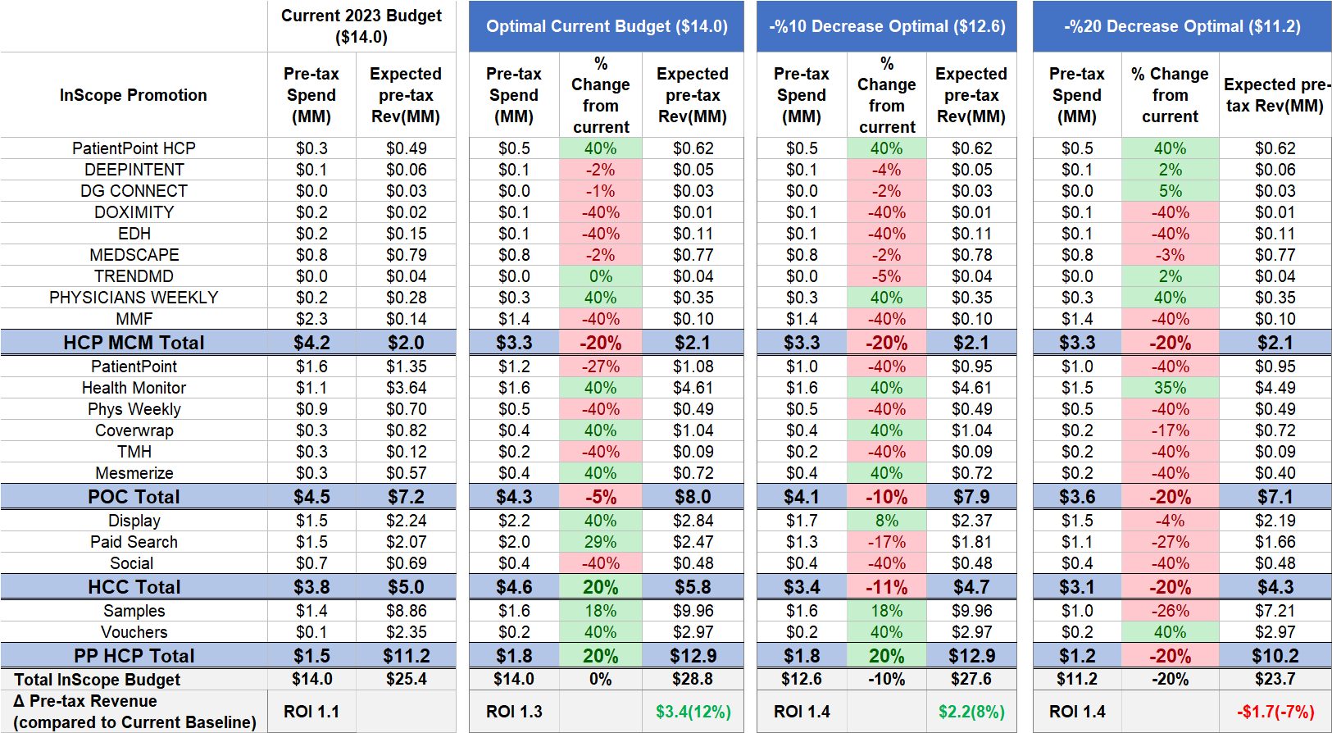
Optimal Scenario deep dive (decreasing scenarios)
With the existing budget, an additional $3.4M in revenue can be gained by reallocating from lower impact to higher impact channels.
*Samples are requested and received by prescribers for use by and benefit of patients. Samples provide the opportunity to gain experience with a product. The sample-related values shown here reflect the association between samples and new patient starts rescaled into TRx terms for comparability to other investment types; this applies to vouchers as well, which are treated as an alternative mechanism to provide samples to patients. (vs. samples left by Field personnel).

Slide 11
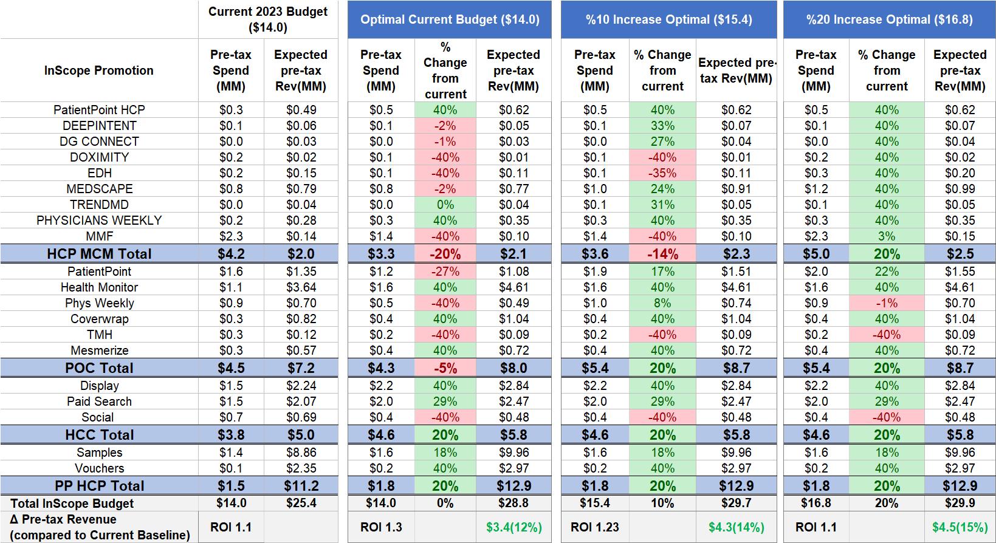
Optimal Scenario deep dive (increasing scenarios)
With the existing budget, an additional $3.4M in revenue can be gained by reallocating from lower impact to higher impact channels.
*Samples are requested and received by prescribers for use by and benefit of patients. Samples provide the opportunity to gain experience with a product. The sample-related values shown here reflect the association between samples and new patient starts rescaled into TRx terms for comparability to other investment types; this applies to vouchers as well, which are treated as an alternative mechanism to provide samples to patients. (vs. samples left by Field personnel).

Slide 12
Next Steps
Receive practical channel level constraints (lower and upper) from the marketing team
Run custom scenarios to take the new constraints into account
Reach a consensus on the final scenario – budget and channel allocation

Slide 13
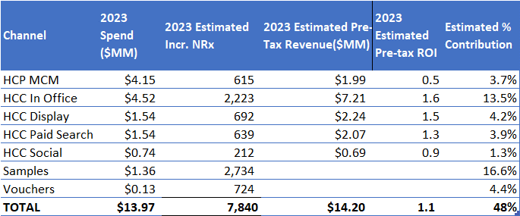
Estimated Pre-tax ROIs and % Contribution for 2023 The Total estimated contribution from all In-Scope promotion channels is 48%

Slide 14
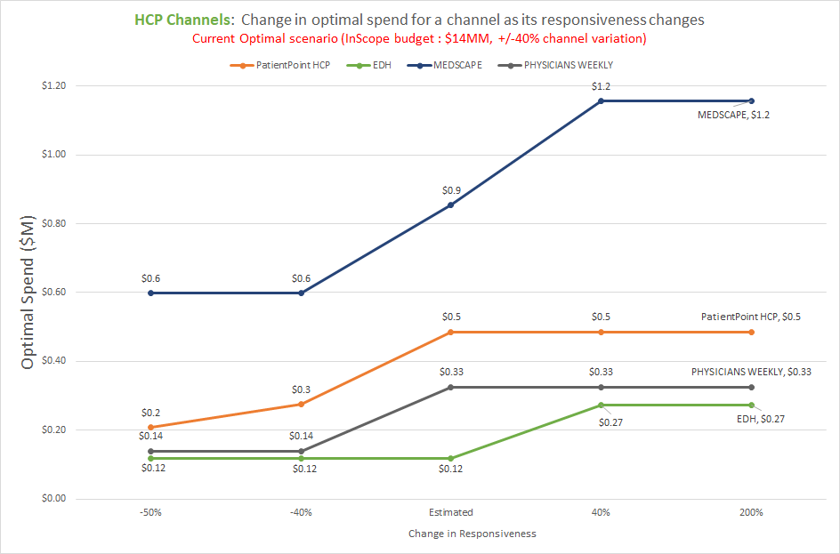
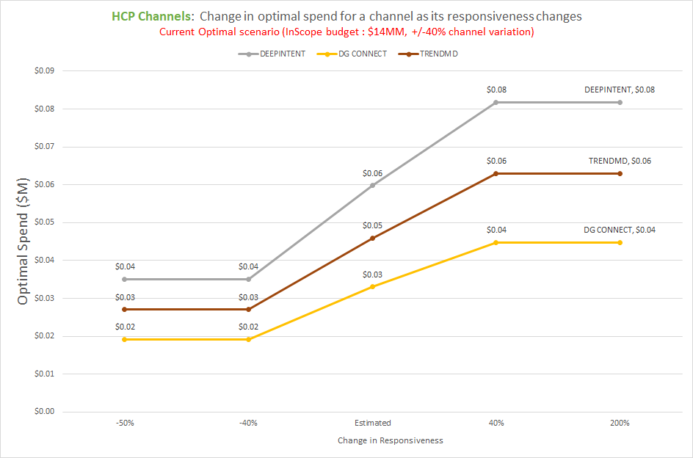
Sensitivity Analysis: HCP Channels (NPP/MMF/Samples/Vouchers)
Points on this line represent the optimal spend for a channel when its response curve is not adjusted
Points on this line represent the optimal spend for a channel when its response curve is not adjusted
Reduced responsiveness
Increased responsiveness
Reduced responsiveness
Increased responsiveness
Please note different scales are used for each graph above
MMF, Doximity, Samples & Vouchers were all insensitive to changes in responsiveness and are therefore not shown on the graphs above.
Observation: Medscape is sensitive to changes in responsiveness between +/-40% of current responsiveness (i.e., optimal spend decreases when response is lower and increases when response is higher)
Observation: PP HCP is NOT sensitive to higher changes in responsiveness (i.e., optimal spend remains the same when response is higher than current level)
Observation: DI, TrendMD, DGConnect are sensitive to changes in responsiveness between +/-40% of current responsiveness (i.e., optimal spend decreases when response is lower and increases when response is higher)

Slide 15
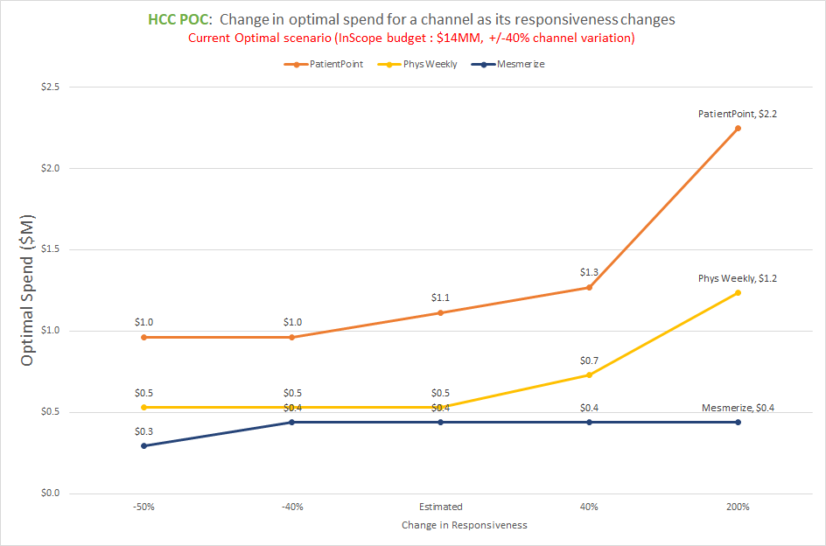
Sensitivity Analysis: HCC POC
Observation: PP HCC is most sensitive to very high changes in responsiveness (200%) (i.e., optimal spend doubles when responsiveness doubles)
Points on this line represent the optimal spend for a channel when its response curve is not adjusted
Observation: Physician’s Weekly is most sensitive to very high changes in responsiveness (200%) (i.e., optimal spend more than doubles when responsiveness doubles) and insensitive to reductions in responsiveness.
Observation: Mesmerize is insensitive to changes in responsiveness except when decreasing to 50% of current response
Reduced responsiveness
Increased responsiveness
Health Monitor, Coverwrap and TMH were all insensitive to changes in responsiveness and are therefore not shown on the graph above.

Slide 16
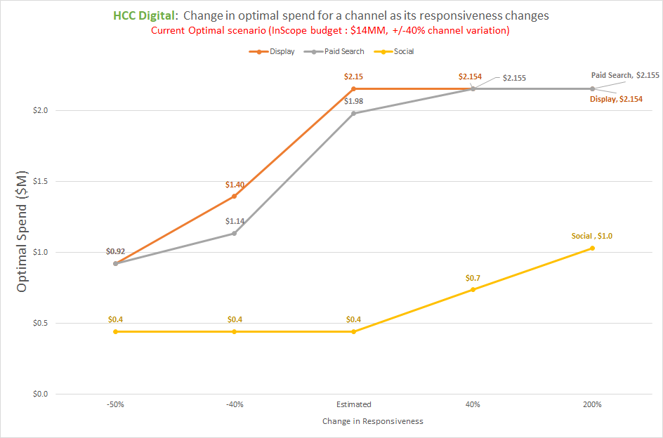
Sensitivity Analysis: HCC Digital
Observation: Display receives reduced budget allocation when responsiveness is reduced by 40% or 50%, while allocations do not change for increase in responsiveness.
Points on this line represent the optimal spend for a channel when its response curve is not adjusted
Observation: PS budget allocation is sensitive up to +40% responsiveness but is insensitive to an increase of 200%.
Observation: Social is most sensitive to increased changes in responsiveness and insensitive to decreases in responsiveness.
Reduced responsiveness
Increased responsiveness

Slide 17
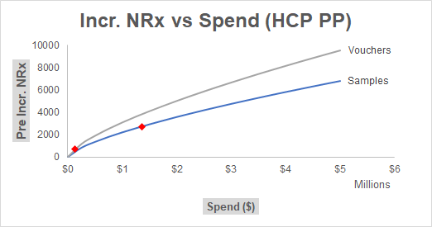
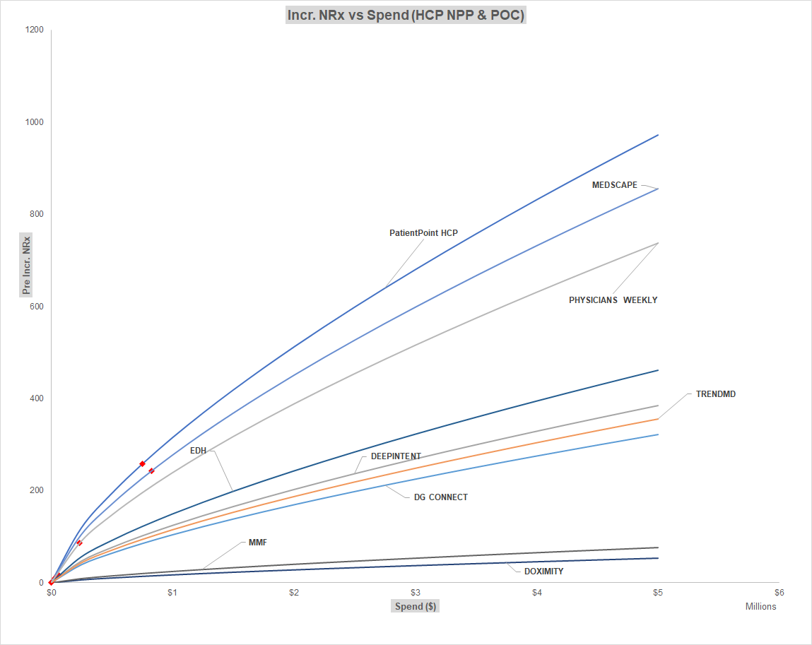
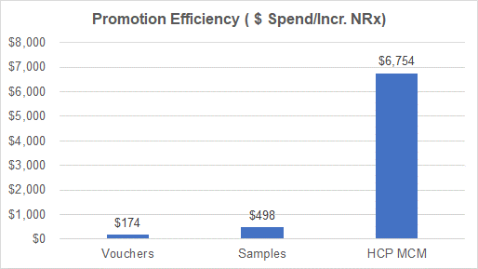
Promotion Deep dive for HCP MCM and HCP PP

Slide 18
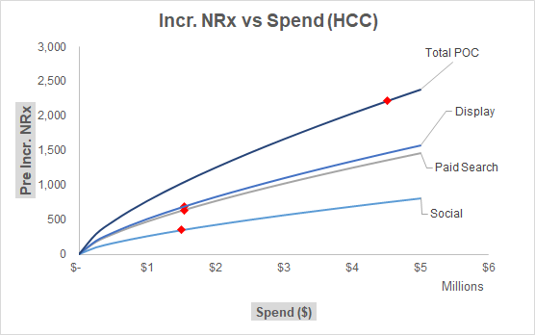
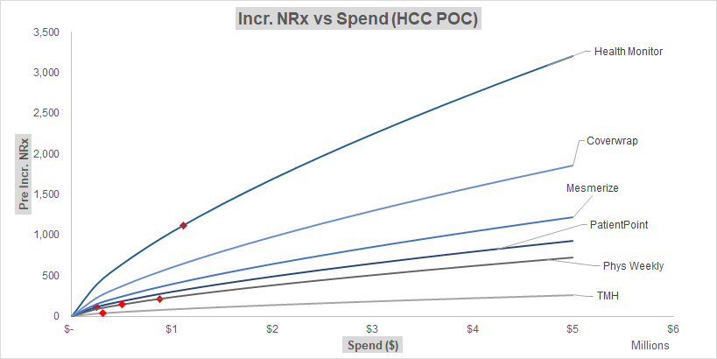
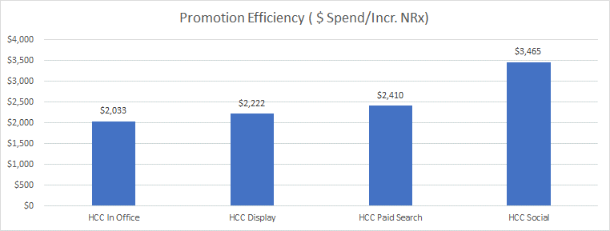
Promotion Deep dive for HCC and HCC POC

